Slide 1


Slide 2







Slide 3


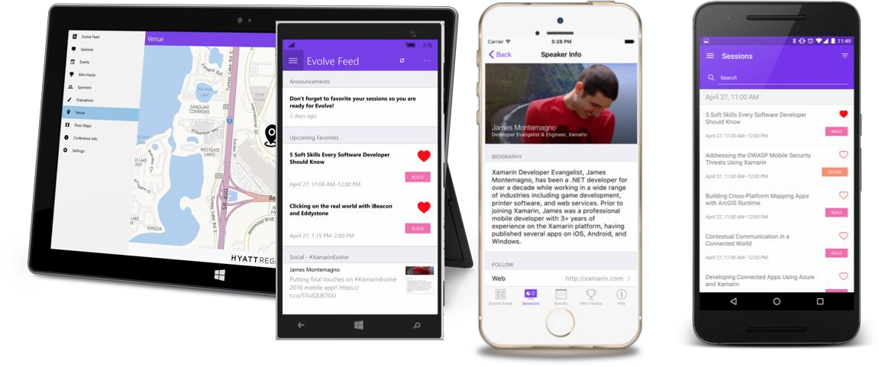

Slide 4






Shared UI Code
iOS C# UI | Android C# UI | Windows C# UI
Shared C# Backend
Shared C# Backend
Traditional Xamarin Approach
With Xamarin.Forms:
More code-sharing, all native

Slide 5


40+ Pages, layouts, and controls
(Build from code behind or XAML)
Two-way data binding
Navigation
Animation API
Dependency Service
Messaging Center
Shared UI Code
Shared C# Backend

Slide 6
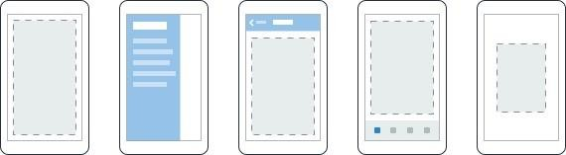
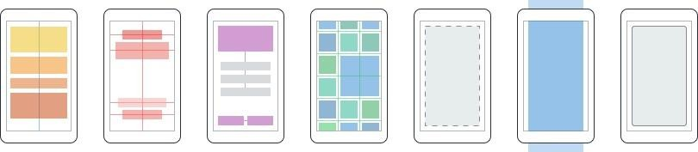
Pages
Content
MasterDetail
Navigation
Tabbed
Carousel
Layouts
Stack
Absolute
Relative
Grid
ContentView
ScrollView
Frame

Slide 7

ActivityIndicator |  | BoxView |  | Button |  | DatePicker |  | Editor
Entry |  | Image |  | Label |  | ListView |  | Map
OpenGLView |  | Picker |  | ProgressBar |  | SearchBar |  | Slider
Stepper |  | TableView |  | TimePicker |  | WebView |  | EntryCell
ImageCell |  | SwitchCell |  | TextCell |  | ViewCell

Slide 8


Xamarin.Forms Ecosystem

Slide 9


Windows | Xamarin.Forms
StackPanel | StackLayout
TextBox | Entry
ListBox | ListView
CheckBox | Switch
ProgressBar | ActivityIndicator
Grid | Grid
Label | Label
Button | Button
Image | Image
Date/TimePicker | Date/TimePicker

Slide 10


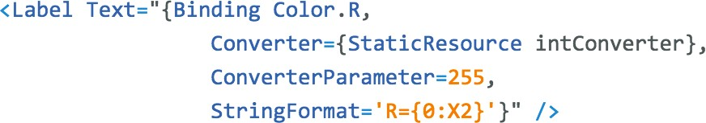
Windows | Xamarin.Forms
DataContext | BindingContext
{Binding Property} | {Binding Property}
ItemsSource | ItemsSource
ItemTemplate | ItemTemplate
DataTemplate | DataTemplate

Slide 11
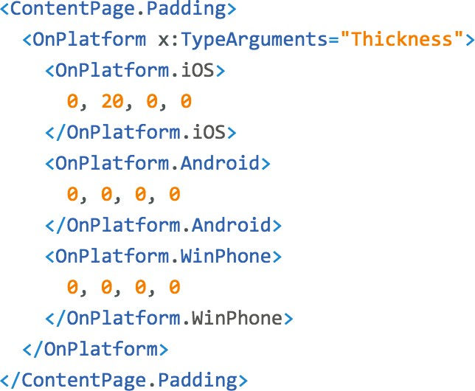



Slide 12
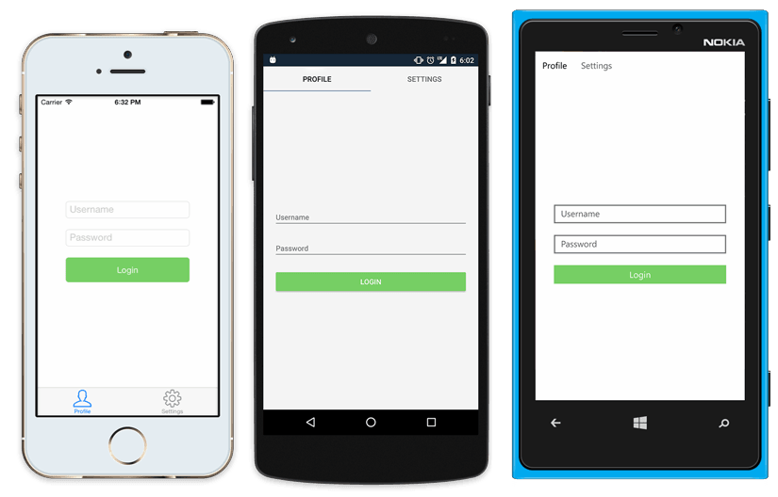
<?xml version="1.0" encoding="UTF-8"?>
<TabbedPage xmlns="http://xamarin.com/schemas/2014/forms"
xmlns:x="http://schemas.microsoft.com/winfx/2009/xaml" x:Class="MyApp.MainPage">
<TabbedPage.Children>
<ContentPage Title="Profile" Icon="Profile.png">
<StackLayout Spacing="20" Padding="20"
VerticalOptions="Center">
<Entry Placeholder="Username" Text="{Binding Username}"/>
<Entry Placeholder="Password" Text="{Binding Password}" IsPassword="true"/>
<Button Text="Login" TextColor="White" BackgroundColor="#77D065" Command="{Binding LoginCommand}"/>
</StackLayout>
</ContentPage>
<ContentPage Title="Settings" Icon="Settings.png">
<!-- Settings -->
</ContentPage>
</TabbedPage.Children>
</TabbedPage>

Slide 13



Slide 14



Slide 15
Xamarin.Forms is Open Source!
open.xamarin.com

Slide 16

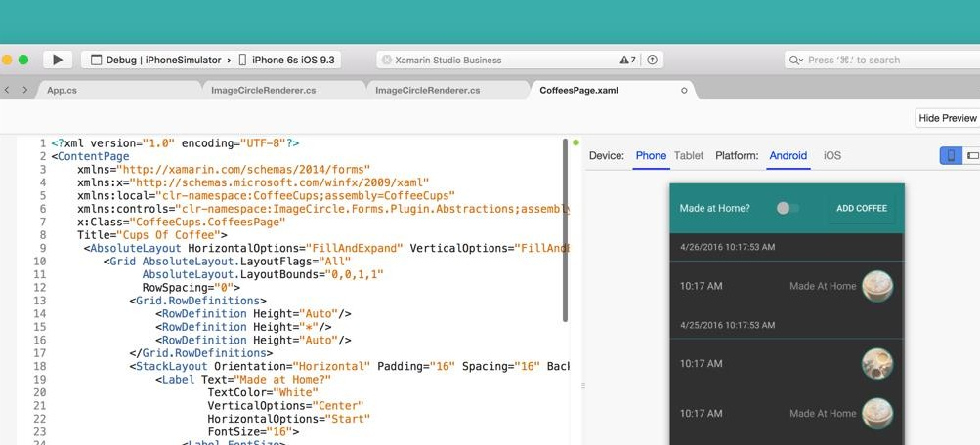

Slide 17

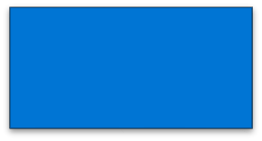
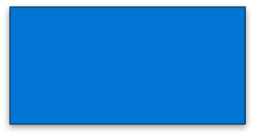
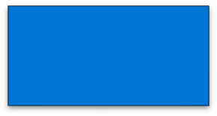
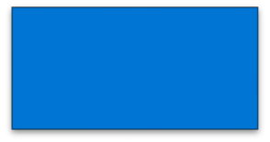
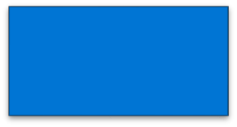
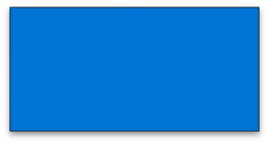
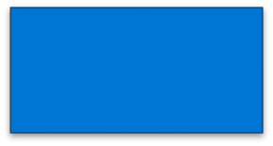
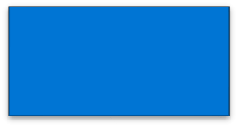

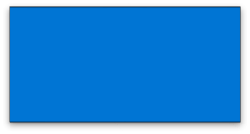
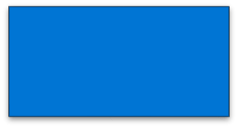
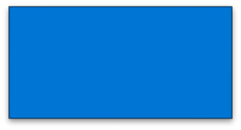
Grid
StackLayout
Grid
ContentView
Button
WebView
Label
Button
Image
ScrollView
Label
Image
FORMS STRUCTURE

Slide 18
Panel
LabelRenderer
ButtonRenderer
WebViewRenderer
LabelRenderer
ButtonRenderer
ImageRenderer
ScrollViewRenderer
TextBlock
Button
WebView
Label
Button
Image
ImageRenderer
Image
WHAT IS PRODUCED NOW

Slide 19
Panel
LabelRenderer
ButtonRenderer
WebViewRenderer
LabelRenderer
ButtonRenderer
ImageRenderer
ScrollViewRenderer
WebView
ImageRenderer
AFTER FAST RENDERERS + COMPRESSION

Slide 20

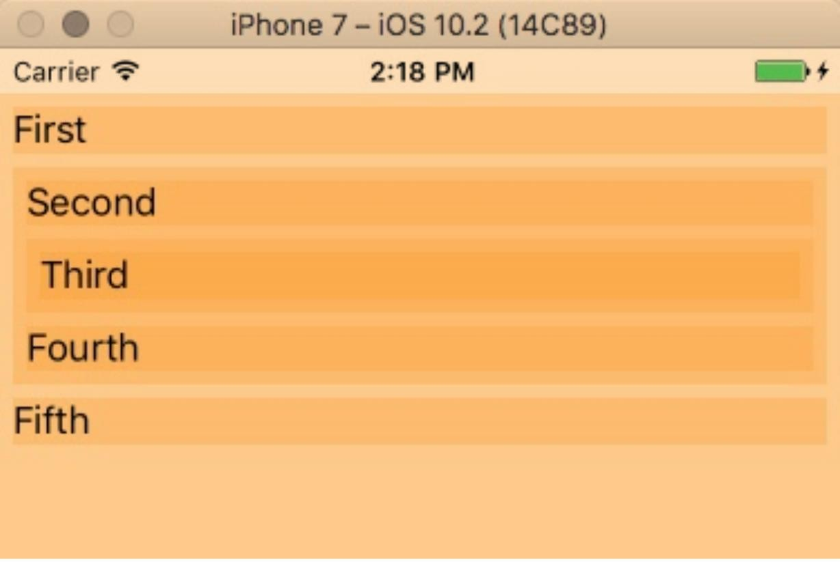
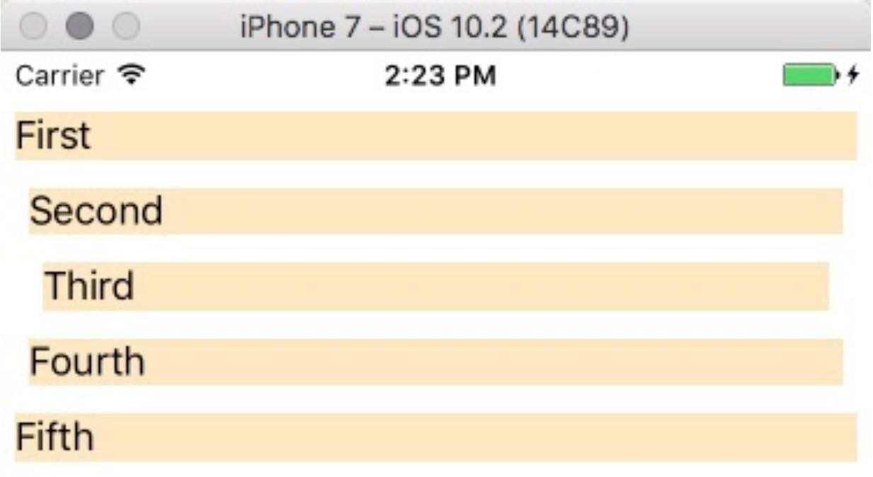

Slide 21
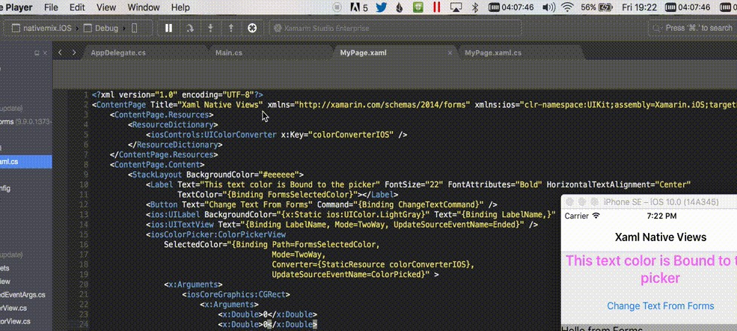

Slide 22
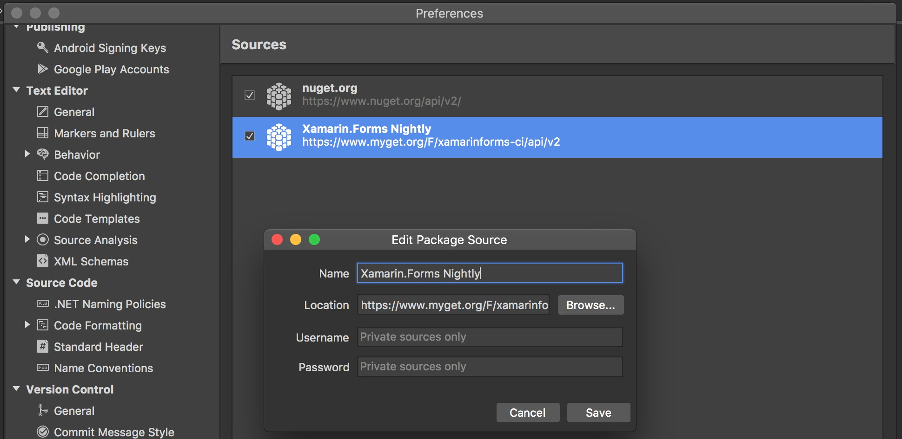
https://github.com/xamarin/Xamarin.Forms/wiki/Nightly-Builds

Slide 23



Slide 24
15 Minute Break
Presenter First Name Presenter Last Name Presenter Title
Presenter e-mail
blogs
Twitter

